Slide 1



PROJECT – 1 Car Rental Software Project
CME1252 Project Based Learning - ||
By
2016510127 Mehmet Tunahan Kanpolat
2019510128 Deniz Küçükkara
2019510085 MUHAMMET ALİ YEŞİLÖZ
IZMIR

Slide 2

Outline
INTRODUCTION
PROGRESS SUMMARY
-Requirements
-Task Sharing
-Scheduling
-Completed Tasks
-Incomplete Tasks: Reasons, Explanations
-Additional Improvements
PROBLEMS ENCOUNTERED
ALGORITHMS AND SOLUTION STRATEGIES
SCREENSHOTS
conclusıon
REFERENCES

Slide 3
Introduction
The purpose of this project is to develop a car rental system for the DEUCENG Car Rental Company.
Our project is a program that includes a car rental company content.
Working cars include things like calculating income and expenses.

Slide 4


Requirements
Eclipse program to use java
Using of the if-else structures,Loop structures
(such as a while loop), definition and usage of
structures, definition and usage of
functions,class and constructors structures
Team management, communication with teammates

Slide 5

Task Sharing
We shared nearly every part of the programming side of the Project.
Everyone wrote their part on the reports.
We also did poster and presentation together.

Slide 6

Scheduling
25th March meeting ,discussing and designing solution alternatives.
29th March Creating the necessary variables, structuresScreen.
1st April. Class designs. Attributes/methods. Add and list commands for office/employee.
5th April Add and list commands for car/customer. Delete commands for office/employee.
8th April Add and list for CarRequest commands. Making contracts. listContract command
12th April Command nextday operations
15th April Preparation of presentation, poster and report

Slide 7
Completed Tasks
Required variables and classes created
The next day command was created properly
Daily rental fees were calculated.
The most important suggestion was made by the system for each office.

Slide 8

Incompleted Tasks
All assigned tasks have been completed

Slide 9
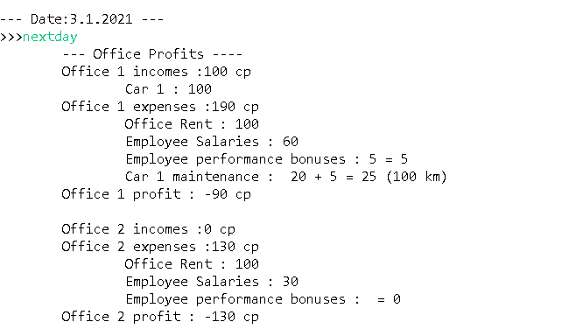
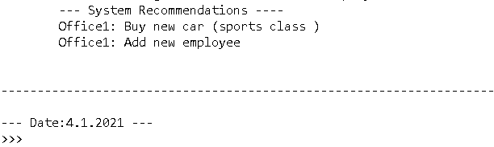
Screenshoots

Slide 10
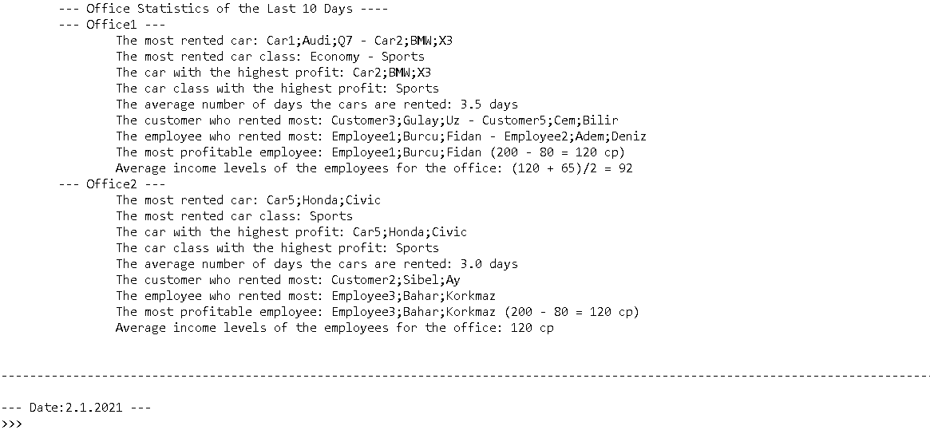
Screenshoots

Slide 11
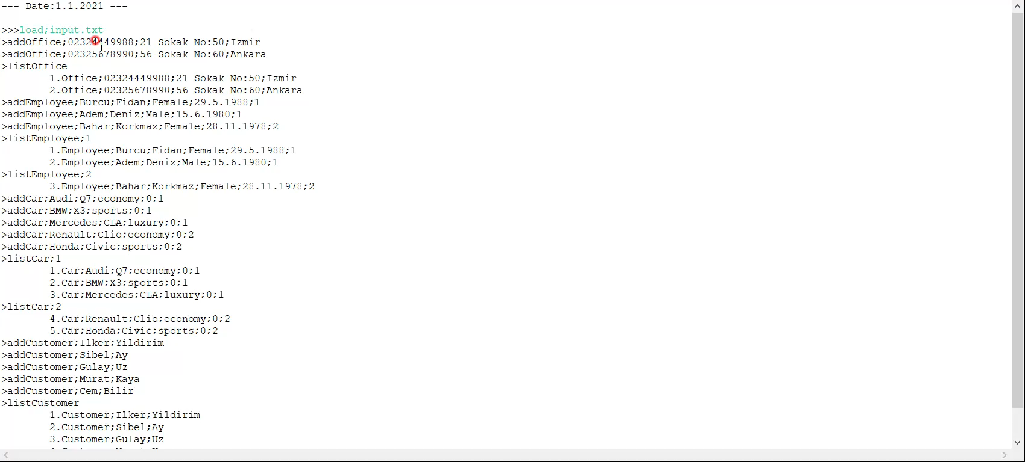
Screen Records

Slide 12

Problem Encountered
While adding random commands,
situations such as absence of office
and absence of employees were
encountered.
Many unknown problems were
encountered while writing the nextday
command, but we realized it was due to
minor mistakes

Slide 13
Algorithms & Solutions Strategies
First of all, we did the necessary research and drew a path for ourselves.
After that, we started to form the program gradually, even if we encountered problems that we could not foresee, we tried to solve them.
We found solutions by helping each other and researching together in places where we usually hang out.

Slide 14


Conclusion
In this project, we learned
Use of class structures.
Use of functions.
How to act as a team.
How to manage time.

Slide 15
References
https://www.java.com/tr/
https://www.udemy.com/course/sifirdan-ileri-seviyeye-komple-ja
https://www.javatpoint.com/how-to-get-input-from-user-in-java
https://www.tutorialspoint.com/java/java_files_io.htm

